Slide 1


Android Lecture #12
Database(SQLite)

Slide 2


Index
Database
Database type
Database Component
Example
Reference

Slide 3
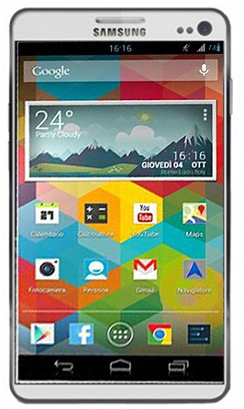
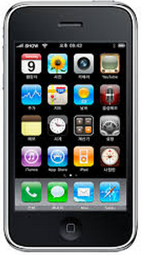

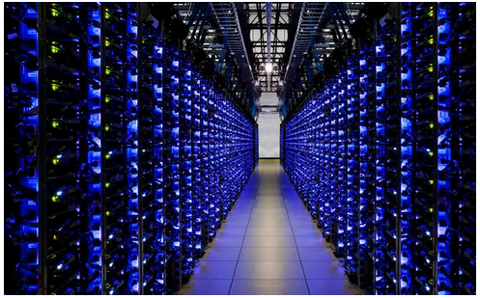
1. Database
Database(DBMS : DataBase Management System)
Store
Manage

Slide 4
Thank you!

